Slide 1

Hangman Network Application
Romain Humair & Lucas Lattion

Slide 2
Introduction
Hangman game (pendu)
Server side
Select random a word
Client side
Guess a letter or a word
The number of guess is set to 7

Slide 3
The protocol
TCP
Default port 9795
Client Messages
GUESS <letter or word> (Client -> Server): The client's guess.
Server Messages
INIT <hidden word> : Welcome message
HIT <hidden word> : The guess was correct. The letter has been added to the hidden word (e.g., "_ A _ _ _").
MISS <attempts left> <hiden word> (Server -> Client): the guess was incorrect. Attempts left was decreased (e.g., 6 "_ _ _ _ _")

Slide 4
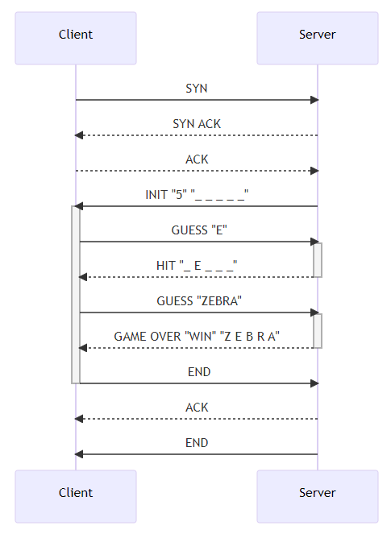
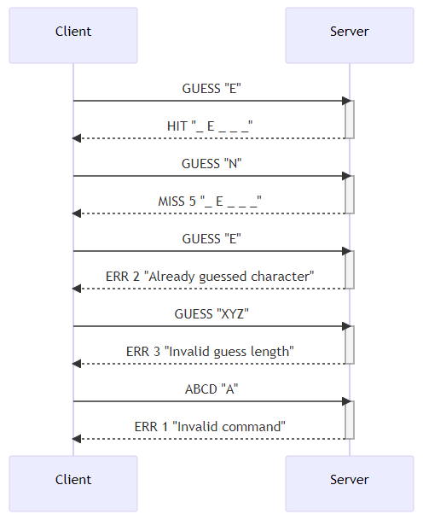
Diagram Example

Slide 5
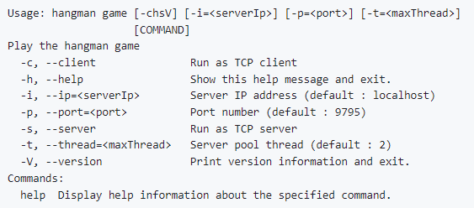
CLI Command
java -jar hangmanGame-1.0-SNAPSHOT.jar -h

Slide 6
Demo

